Slide 1
What facilitation can do in the most unequal country in the world ?
Discussion with the IAF Social Inclusion Group
11 August 2021

Slide 2
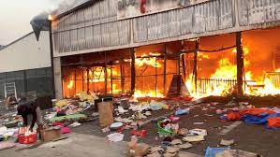
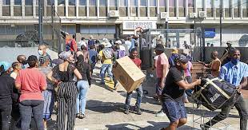
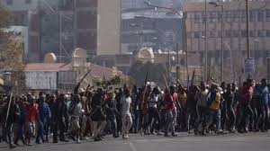
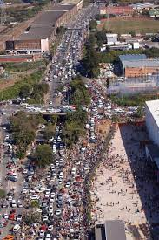
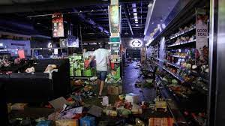
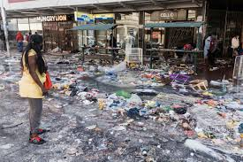
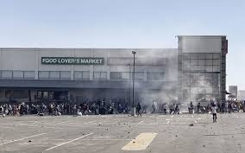
Scenes – looting and rioting – South Africa July 2021

Slide 3
Overview
Inequality in perspective
State roles split across national, provincial and local government
Local government roles
Policy making role
Local Economic Development
Integrated Development Plans
Public Participation
State of local government
A City in Pieces

Slide 4
Facets of Inequality in South Africa
Gini coefficient – measure inequality – 0 = perfectly equal distribution of wealth; 1 = one person owns everything
Gini coefficient in South Africa of 0,67 in 2006, dropping to 0,65 in 2015 (Stats SA); expected to be 0,63 in 2021 (World Population Review)
Palma ratio - top 10% of the population spent 8,6 times more than the bottom 40% in 2006; ratio reduced to 7,9 in 2015
South African labour market is heavily racialised and gender-biased
Largest contributor to overall income inequality came from the labour market at 74,2%.
Female workers earn approximately 30% less, on average, than male workers
Mean real earnings between 2011 and 2015 amongst employed black Africans was R6 899 (real earnings) p. m. Mixed race & Indians/Asians - R9 339 and R14 235 p. m. For Whites, it was R24 646 per month

Slide 5
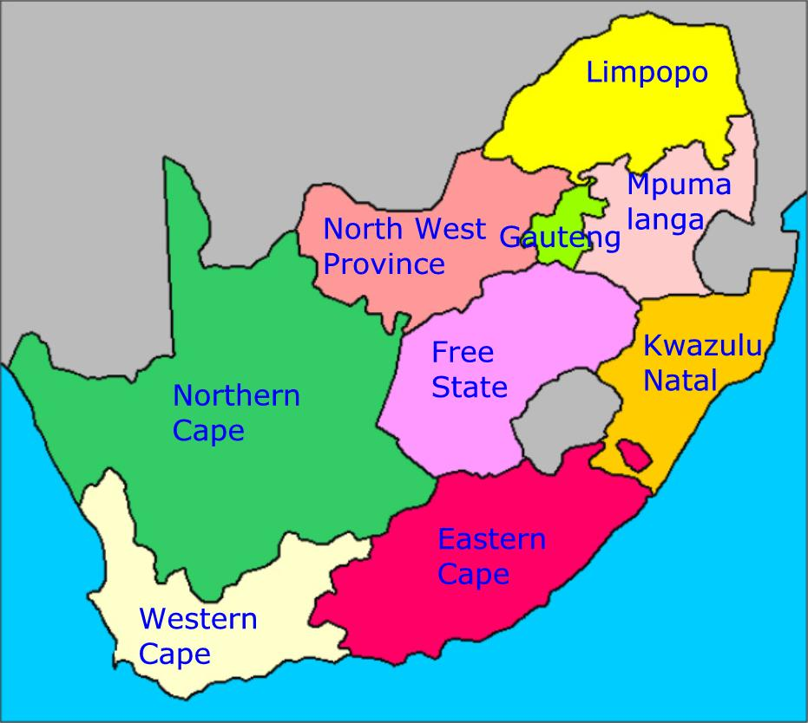
Provinces in South Africa

Slide 6
Facets of Inequality in South Africa - 2
Eastern Cape - highest levels of inequality in 2015, with the Western Cape and Mpumalanga coming in second
The bottom 60% (9.66m) of households depend more on social grants and less on income from the labour market (57.7 million people & 16.1 million / households in South Africa)
Prof Ranchod – UCT – inequality – prime cause - high levels of unemployment
Unemployment - leads to income inequality - black people and women in South Africa are adversely affected – 32.6% / 43.2% (expanded) / 46.3 youth – June 2021
Inequality manifests in different ways - gender inequalities, urban and rural dweller inequalities, education inequalities, and racial inequalities
“Short of massively disruptive social change, in the form of revolutions, what we need is a policy system which thinks systematically and substantially.” (21 May 2021)

Slide 7
State of Housing – Inadequately Housed
Informal dwelling/shack not in backyard, e.g. in an informal/squatter settlement or on farm: 1 334 598 (8.2%)
Traditional dwelling/hut/structure –
traditional materials: 897 592 (5.5%)
Informal dwelling/shack in backyard: 869 229 (5.4%)
Unemployment in informal settlements – up to 80%
13.6 % of SA in informal housing – 2.2m households

Slide 8
Policy Context
Freedom Charter - There shall be houses, security and comfort
Constitution of South Africa - Chapter 2: Bill of Rights - Everyone has the right to have access to adequate housing, jobs etc
Econ Dev Policy – many constraints:
Wholesale programmes from national agency – lack of system for training / accrediting trainers – funding framework lacking for NGOs - Need fixed address for finance
Limited & uneven access at local level & Partial support for cooperatives
Premises, land, equipment – scarce & complex to assess
Dispersion across silos
Weak educational and technical foundations
Poverty mentioned everywhere – though approach dispersed and unfocused

Slide 9
Core Pillars of Revised Led FW
Building a diverse & innovation driven local economies
Developing inclusive economies
Enterprise development & support
Developing learning and skillful economies
Economic Governance and Infrastructure
Strengthening Local Innovation Systems

Slide 10
Integrated Development Planning - IDPs
Local municipalities in South Africa have to use "integrated development planning" - method to plan future development in their areas:
Motivation:
Integrate - racially divided business and residential areas
Overcome bad planning to cater for the poor - with long travelling distances to work and poor access to business and other services
Reduce - great differences in level of services between rich and poor areas
Informal settlements and spread out residential areas economical service delivery difficult
Effective use of scarce resources
Speed up delivery
Attract investment

Slide 11
Public Participation
IDP Representative Forum be established to encourage the participation of communities and other stakeholders
Provide an opportunity for stakeholders to represent the interests of their constituencies.
Provide a structure for discussion, negotiations and joint decision making
Ensure proper communication between all stakeholders and the municipality
Monitor the planning and implementation process
Strategy for public participation – Key Role of Council
The roles of the different stakeholders during the participation process
Ways to encourage the participation of unorganised groups
Method to ensure participation during the different phases of planning
Timeframes for public and stakeholder response, inputs and comments
Ways to disseminate information
Means to collect information on community needs

Slide 12
State of Local Government
Service Delivery Protests – Alexandra Township, April 2019

Slide 13
State of Local Government (Mbanyele, May 2021, Good Governance Africa)
Local governance - focus on public administration, factoring in transparency, accountability, and efficiency
Yet –widescale evidence of mismanagement - poor audit outcomes & exposure of irregular and wasteful expenditure in those audits
No material consequences for this malfeasance
Root cause corruption, lack of credible accountability structures and individual agency characterised by impunity
Dysfunction in many of the country’s municipalities:
Political infighting -
Drawn-out court cases
Dissatisfaction has led to pressure to form coalitions – led to instability and poor governance

Slide 14
Sorry Tale of City in Pieces https://www.newframe.com/pietermaritzburg-a-city-in-pieces/ Zama, L , July 2021
“Widespread looting and destruction in Pietermaritzburg could signal the death knell for a place already brought to its knees by municipal neglect and the greed of those in power.”
Gunfire, smoke and mounting rubble on every street are becoming average.
midst of the pandemic that forced us to stay at home, some of us spent five days without electricity,
persistent dereliction of municipal duty has seen Pietermaritzburg fall into decay. The result is that it has become one of the most murderous parts of the country. Human life is worth less here than almost anywhere else in South Africa,
Filth is nothing new to communities that have to remind the municipality that it is supposed to pick up the trash on certain days. Looting, however, is deeply unnerving. It is a bridge too far and many young families are now wearily reconsidering the feasibility of allowing themselves to be at the mercy of the criminal elements among the rioters that hit the city

Slide 15
Sorry Tale of City in Pieces https://www.newframe.com/pietermaritzburg-a-city-in-pieces/ Zama, L , July 2021
“The people of this once-proud city are exhausted. When grown children have to sleep in their mothers’ beds as fathers stand guard with whatever weapons they can find, you know you have breached human rights and moved into collective wrongs.”
“This was a city of endurance, characterised by the ultra-distance marathon that started or stopped here. But that emotional well of perseverance seems to have run as dry as the petrol stations in the area.”

Slide 16
Options for an Inclusive Future
Go back to street committees as form of community organisation
More NGO interventions – Gift of the Givers, SERI
Social Movements
A Mall is NOT development. Township Malls are instruments of poverty and exploitation – vs local production
Policy on 70% local for certain goods/merchandise - Malls to set aside 30% of floor space for local business.
Restrict big cartel anchors like Checkers/Shoprite to one shop per mall per 20km radius.

Slide 17
Group discussion:
What can be the role of facilitation in supporting inclusive development?

